Slide 1
Large Language
MadLibs
Part 1
Created by Kristin Fasiang and the Creative Interfaces Research + Design Studio

Slide 2
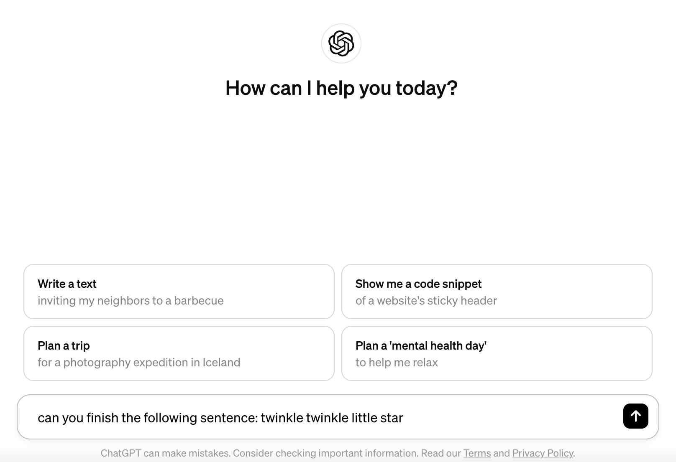
Exploring ChatGPT
How would you finish the following sentences?
Twinkle twinkle little star…
You’re insecure, don’t know what for…
Once upon a time…
My favorite memory is…
Now, go to chat.openai.com and ask the same questions to ChatGPT:
“Can you finish the following sentence: [type sentence starter]”

Slide 3
AI and You
How are your own responses similar to ChatGPT’s? Different?
AIs like ChatGPT are built using huge amounts of text taken from the internet.
When our responses are similar to ChatGPT’s, that makes sense, since ChatGPT is built on thoughts that people like us have put out onto the internet!
When our responses are different from ChatGPT’s, though, that also makes sense– people have all sorts of opinions and ways of speaking online.

Slide 4
How Does It Work?
Brainstorm: how do you think the technology might work.
(A helpful starting point is that AIs like ChatGPT rely on huge amounts of text taken from the internet. Why might they need all that text? How do they use it?)
Read the New York Times article “Let Us Show You How GPT Works– Using Jane Austen” (link)

Slide 5
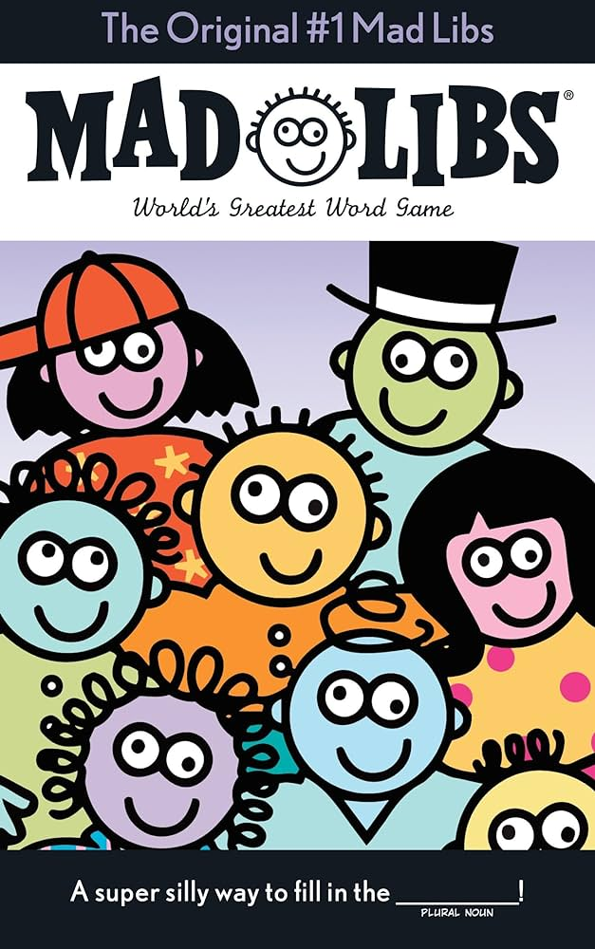
Early Stages
When we start training an AI to generate sentences, we might think about filling in _________ in a sentence!
blanks
In the early stages, the AI will make random guesses to fill the blanks, since it doesn’t know enough about the surrounding words to have them influence its guesses.
This means that each blank is independent of the other blanks and words around it (just like it is for you when you fill in a MadLib!)

Slide 6
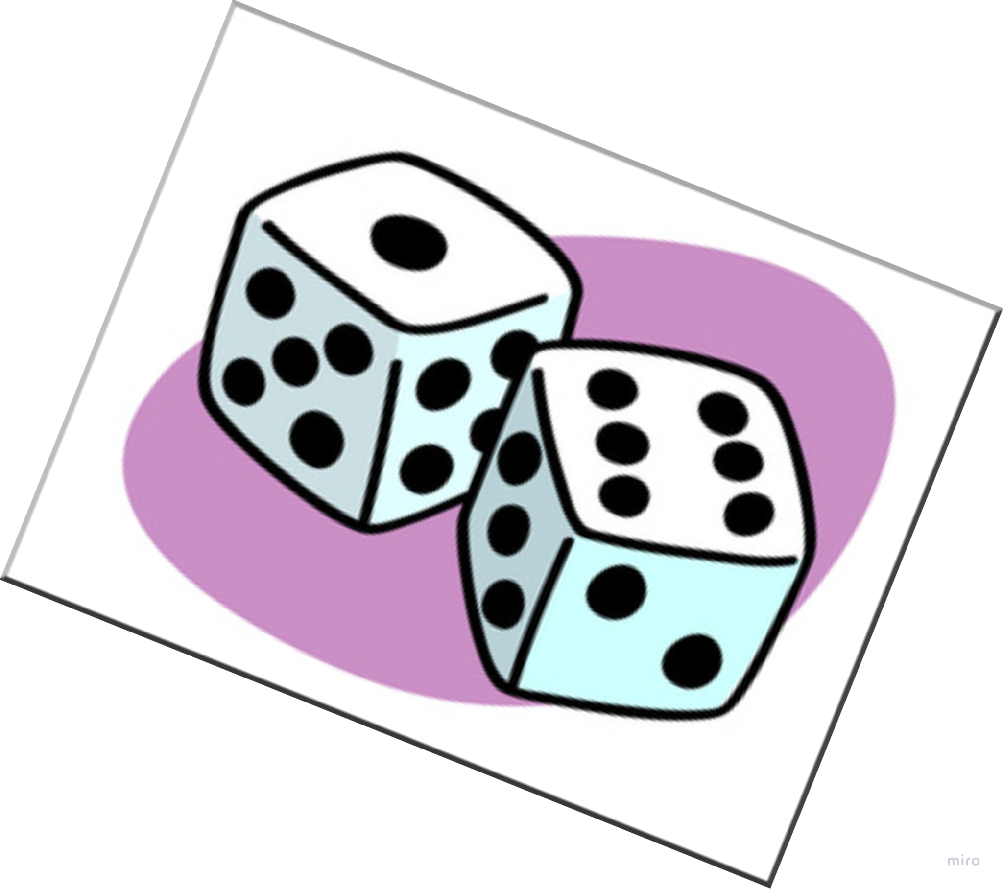
Instructions
Roll two dice
Click the link to go to the page for that roll
Fill in the blank with the word given
Repeat!
The story:
Today I went to the _________. While I was there I saw a _________. It was _________ very wildly, and even _________ from the _________. Pretty soon, they were all _________ and _________. I thought all of this was very exciting, and soon I was _________ it out to my friends. Eventually, though, they all went back to _________ and the rest of the day was pretty boring in comparison.

Slide 7
Roll the Dice
2
3
4
5
6
7
8
9
10
11
12

Slide 8
2: ZOO
Back to Dice Page

Slide 9
3: DANCING
Back to Dice Page

Slide 10
4: ELEPHANT
Back to Dice Page

Slide 11
5: YELLING
Back to Dice Page

Slide 12
6: POINTING
Back to Dice Page

Slide 13
7: LAUGHING
Back to Dice Page

Slide 14
8: RUNNING
Back to Dice Page

Slide 15
9: CITY
Back to Dice Page

Slide 16
10: TANNING
Back to Dice Page

Slide 17
11: PEOPLE
Back to Dice Page

Slide 18
12: GROWING
Back to Dice Page

